Slide 1

CAVA Analytics
Riccardo Soldan
March 2023

Slide 2

Content
Brief recap on climate models
What data is available from the HUB
Introduction to the core functions of CAVA Analytics
Conclusion

Slide 3
General Circulation Models and Earth System Models
GCM and ESM are the most advanced tools used to simulate the effect of increasing greenhouse gas concentrations on the global climate system
ESMs differ from GCMs because GCMs do not account for carbon movement through the earth system
Atmospheric circulation and radiation
Climate Model
Sea ice
Ocean circulation
Land physics and hydrology
Atmospheric circulation and radiation
Interactive CO2
Earth System Model
Sea ice
Ocean biogeochemistry
Plant ecology and land use
Ocean circulation
Land physics and hydrology

Slide 4
CORDEX
CMIP models cover the entire world (GCM) at different spatial resolutions (CMIP5 models were at 1-2°, which corresponds to 100-200Km)
Not ideal for representing regional climate and supporting adaptation assessment and planning
The Coordinated Regional Climate Downscaling Experiment (CORDEX) provides projections with much greater detail and more accurate representation of localized extreme events (50 km resolution)
GCM
Dynamical downscaling
RCM (Regional Climate Models)
GCM-RCM simulations

Slide 5
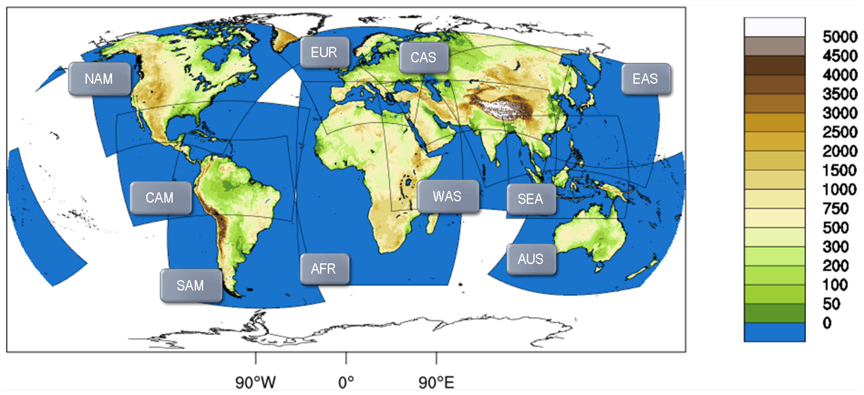
CORDEX
Since GCM are dynamically downscaled through RCM, these are region specific
Several RCMs exist. In CORDEX, no specific requirements for the number of GCM-RCM combinations available in each domain

Slide 6
CORDEX-CORE
CORDEX-CORE harmonizes the selection of GCM and RCM across different domains.
6 simulations per domain available (3 GCM downscaled with 2 RCM).
The selection of GCM was based on climate sensitivity (from low to high).
25 km spatial resolution.
CORDEX and CORDEX-CORE are currently only available for CMIP5 models.
CORDEX CMIP6 will already provide data at 0.25 Km resolution and CORDEX-CORE will cease to exist

Slide 7
Data available in the HUB
Current data available
Observed climate data (1980-2016). Pr-tasmax-tasmin, tas, wind, hurs
Two future scenarios (rcp2.6 and rcp8.5) from 2006 to 2100
6 GCM-RCM models per domain

Slide 8
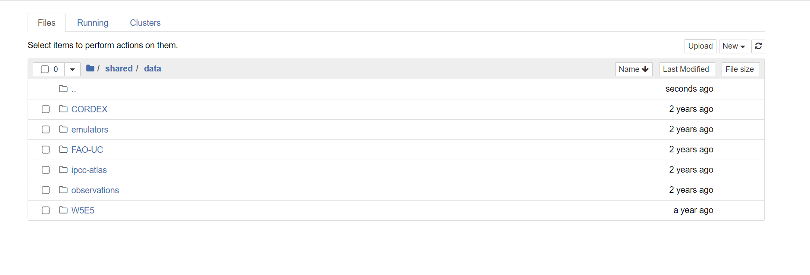
Data available in the HUB
This data is available in the “shared” folder

Slide 9
CAVA Analytics
Thus, the HUB allows user to access computational resources and data. It is a pre-defined environment that facilitate CORDEX climate models data retrieval for any location in the world. This is already a big achievement.
However, how can intermediate users work with multiple climate models and visualize results? This is what CAVA Analytics does!
CAVA Analytics allows user with limited programming skills to load and perform fairly complex climate analyses in the cloud

Slide 10
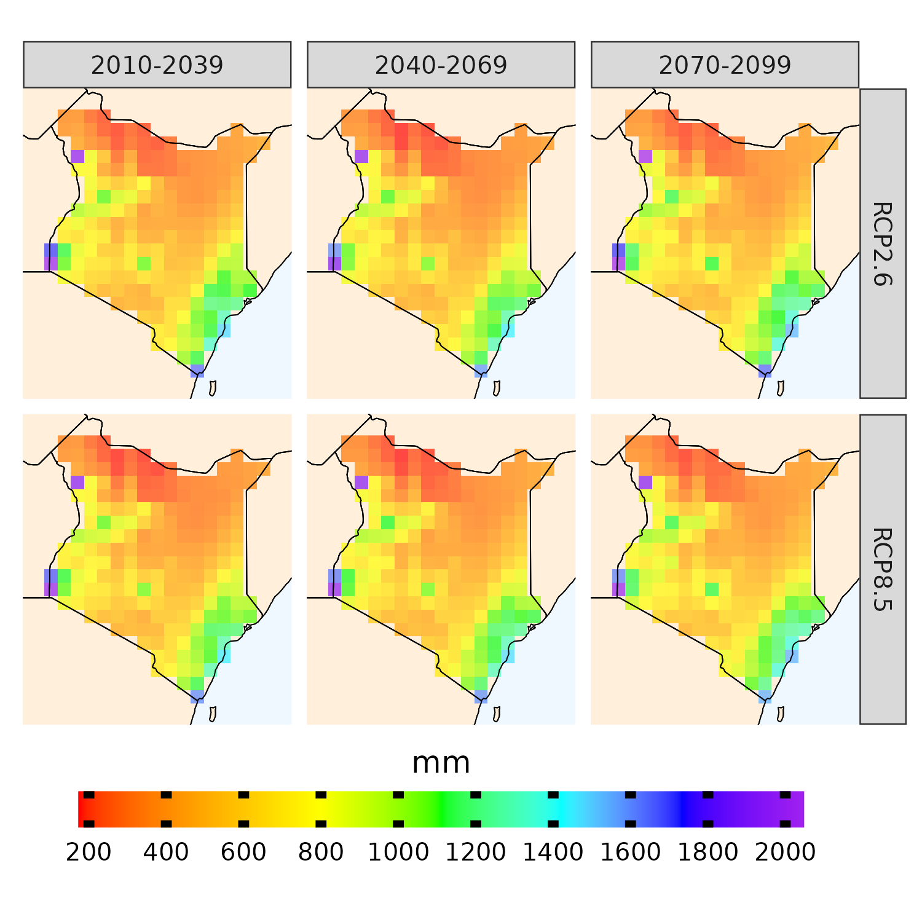
CAVA Analytics functions
Historical
Load the data
Projections
Climate change signal

Slide 11
Conclusion
The HUB is an extremely flexible resource. What you can do mainly depends on your programming skills
Users can simply use CAVA Analytics or have the freedom to perform their own analysis with the available data

Slide 12
Thank you! Contact details: riccardo.soldan@fao.org

